Slide 1

Reliable web hosting on raspberry pi: a self-adaptive approach
Group 7 – Arthur Li, Daniel Almeida

Slide 2
Problem Statement
Key Issues
Downtime
Inefficient resource allocation
Manual labor
Implications
Reduced user confidence
Operational Costs
Overprovisioning
Unrealized potential
Motivation
Remote location
Weather impact
Resource constrained

Slide 3
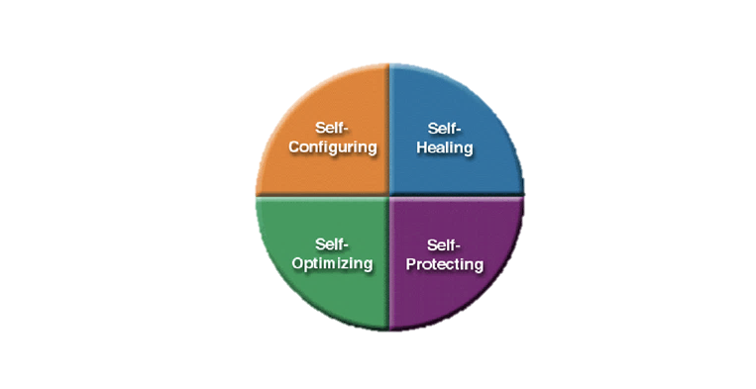
Proposed Solution
At its core: A self-adaptive web hosting framework
Framework: MAPE-K (Monitor, Analyze, Plan, Execute, Knowledge)
Mechanisms:
CPU clock speed adjustments
Content degradation
Watchdog timer
Apache caching
Anomaly detection model

Slide 4
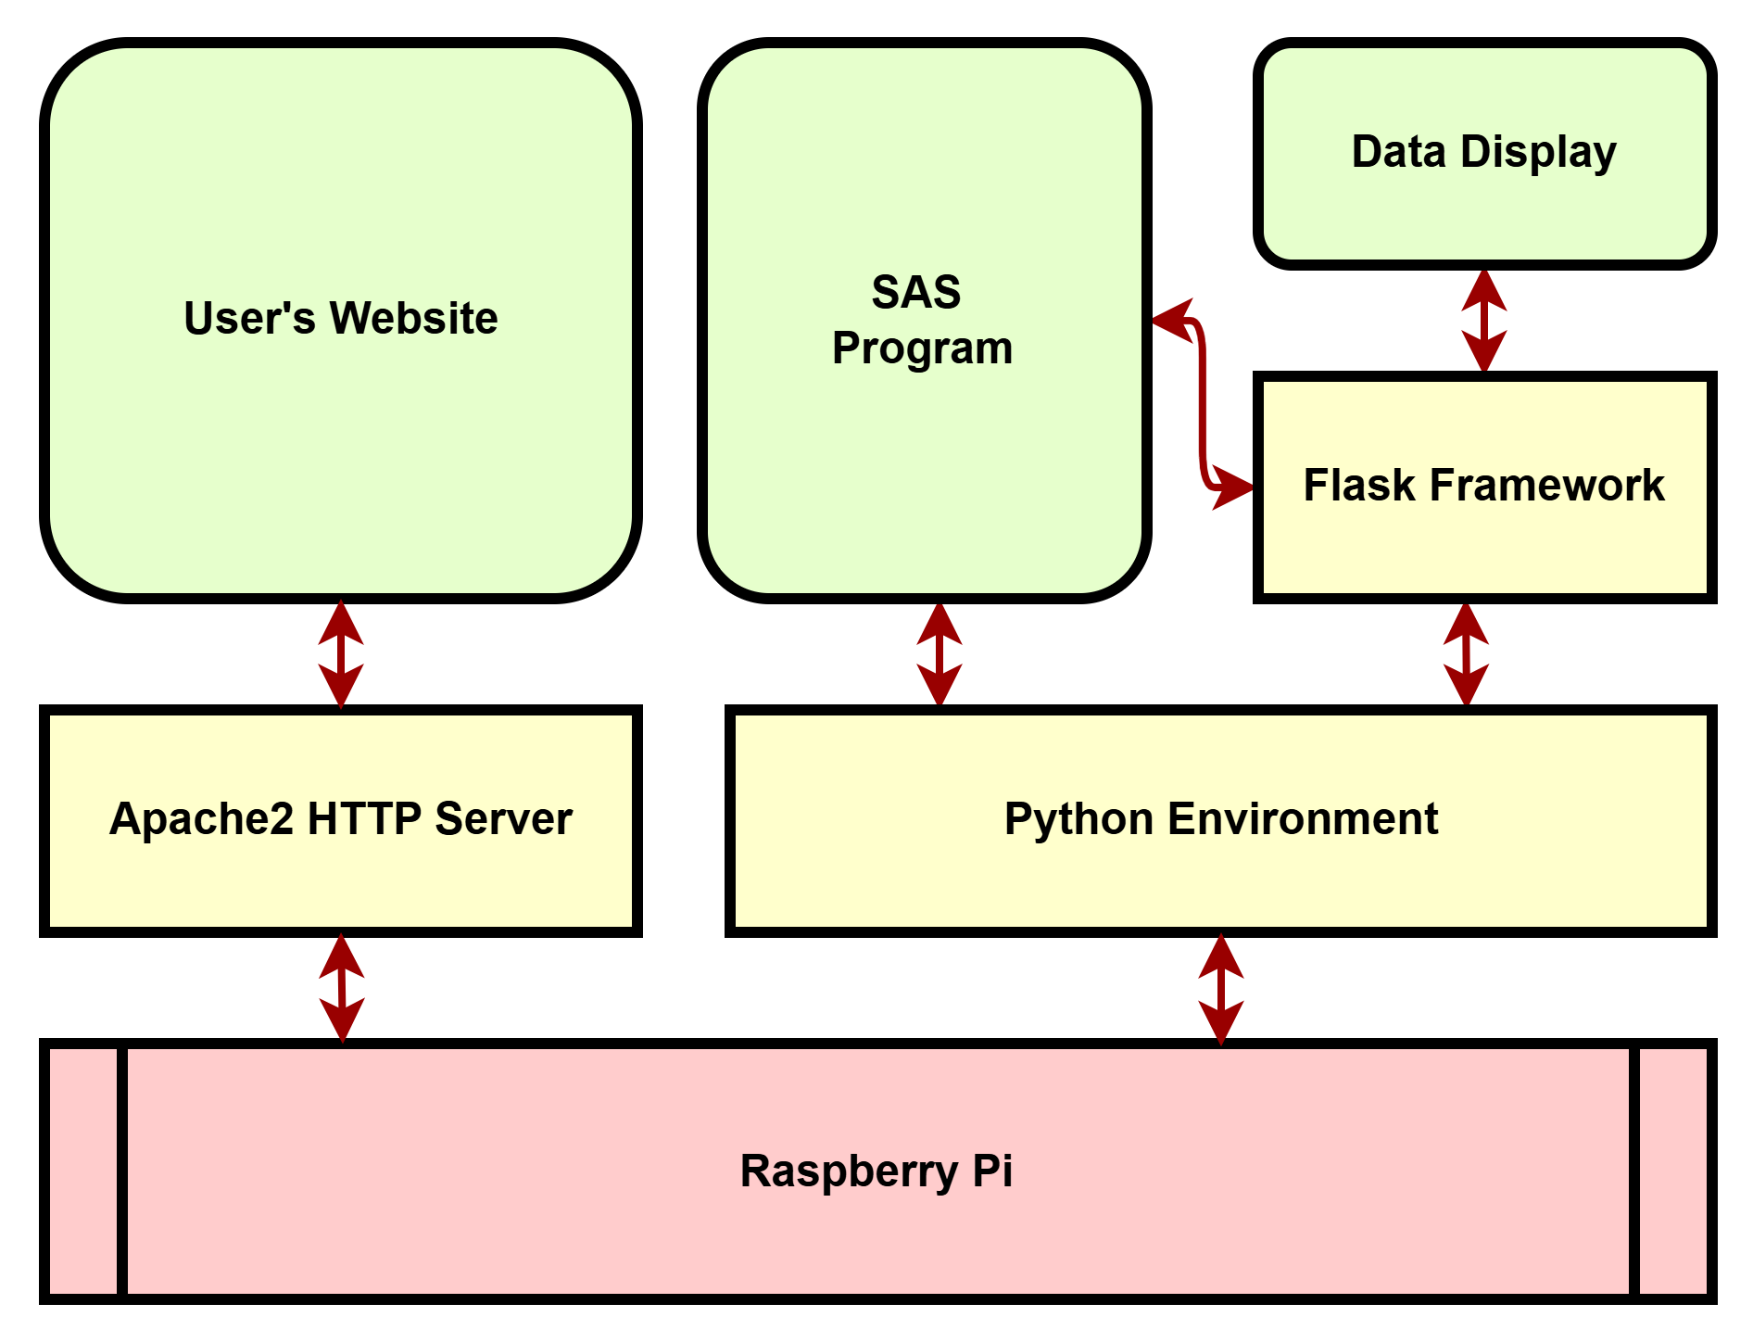
Proposed Solution
Hosting and Server
Apache HTTP Server
Flask
Programming and Frameworks
Python
Threading
Monitoring/Metrics
Psutil
Testing/Validation
Jmeter
Syslog
Data Analysis
Pandas, Scikit-learn, Joblib
External
OpenWeatherMap API

Slide 5
Outcome
Adaptive framework improves RPiWeb hosting
Dynamic adaptation optimizes performance and system stability under fluctuating traffic loads
Automatic reboot mechanisms ensure minimal downtime and uninterrupted hosting
Optimal thresholds reduce content oscillation and enable efficient resource allocation

Slide 6
Challenges and Future Work
Challenges
Weak model
Verbose implementation
Future Work
Scaling
Historical data

Slide 7
References
[1] J. O. Kephart and D. M. Chess, "The Vision of Autonomic Computing," IEEE Computer Magazine, pp. 41-50, Jan. 2003
[2] L. Tahvildari, ECE750-T37: Engineering Self-Adaptive Software Systems, Lecture 1, Dept. of Elect. and Comp. Eng., University of Waterloo, 2024
[3] D. Weyns, An Introduction to Self-Adaptive Systems: A Contemporary Software Engineering Perspective, Wiley-IEEE CS Press, Oct. 2020

